Slide 1
E-Library management system
S.Jeevan Babu(N160102)
P.Manikanta(N160108)
D.Manikanta(N160294)
K.Eswar(N160338)
R.Pravallika(N160802)
K.Satya Durga Lakshmi(N160829)

Slide 2
Table of Contents
Abstract
Existing System
Proposed System
Introduction
Hardware & Software Requirements
Output
Conclusion
References

Slide 3
Abstract
Online Library Management System is a system which maintains the information about the books present in the library, the members of library to whom books are issued, library staff and all.Secure login provides the safety for our information.Maintenance of all this information manually is a very complex task. Owing to the advancement of technology, organization of an Online Library becomes much simple. The Online Library Management has been designed to computerize the operations performed over the information about the members, book issues and returns and all other operations .This simple and good looking user interface is user-friendly for both beginners and advanced users and greatly reduces manual work and time.

Slide 4
Existing System
Now a days most of the Libraries are working manually. It requires a lot of time and man power to record or to retrieve the details. The one who performs the operations must need to do their job very carefully. Even a small mistake would create a problem.
All the information regarding the library operations are recorded on the paper books. Paper books are vulnerable to many physical aspects.
In offline library system ,students don’t know that which books are available and which are not. To find out the books ,students have to visit the library personally.

Slide 5
Proposed System
We are proposing an E-Library Management System that aims at developing a computerized application to maintain all the day-to-day activities of a library .
This system offers an Good looking UI and Easy Navigation . It will reduce the human effort by using the automated operations that are present in the system.
Students have to register in the application to gain the access . By logging into the system, this system provides so many great featues that will please the end user(Student & Administrator).

Slide 6
Introduction
In this digital era java based library management system would be ideal for students who can access the library’s database on their devices through online.
The library management system software makes the library a smart one by quick response with efficiency. Simple and good looking user interface enables the users to search books quickly and effortlessly. This application goes through series of operations to perform different types of functionalities
This E-library management system contain two parts:
1. Admin : Admin is the main role of this system who manages book issuing, book returning ,sending notifications etc.
2. Student : Students can see the book information and can track their registered books.

Slide 7
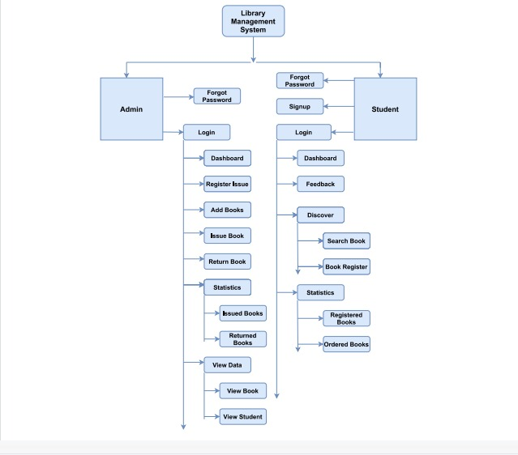

Slide 8
Advantages
No intruder can log in and modify the data, as a login for admin is available.
It is user friendly software, simple and understandable to the users.
Cost effective and easy to maintain.
It saves time and decreases effort.
Very Less chance of error

Slide 9
Requirements
Hardware Requirements:
i3 Processor based computer.
4GB-Ram
CPU Time
Software Requirements:
NetBeans
JDK 10 above
Java Swings&AWT
Windows 10
Database- MYSQL
mysql-connecter -java, jcommon.jar, jfreechart.jar

Slide 10
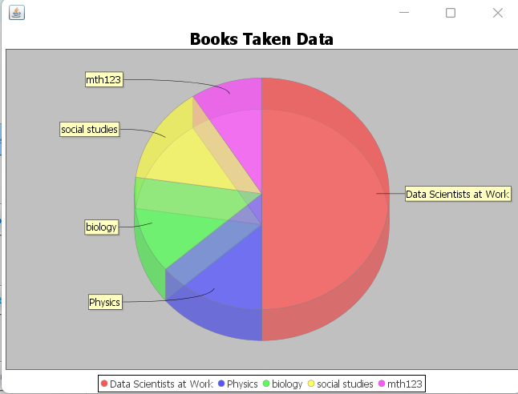
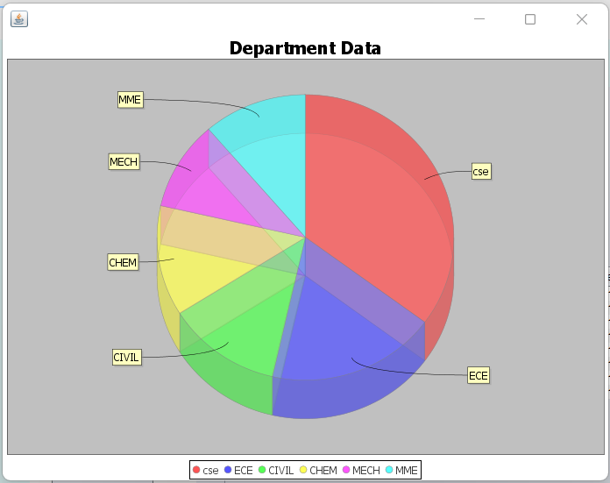
Outputs:
Pie Charts

Slide 11
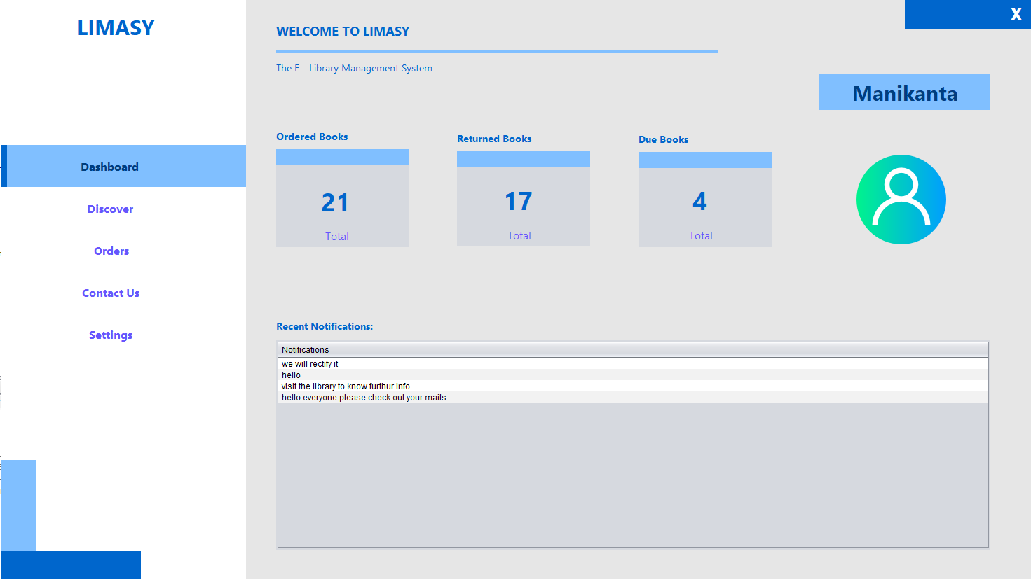
Student User Interface

Slide 12
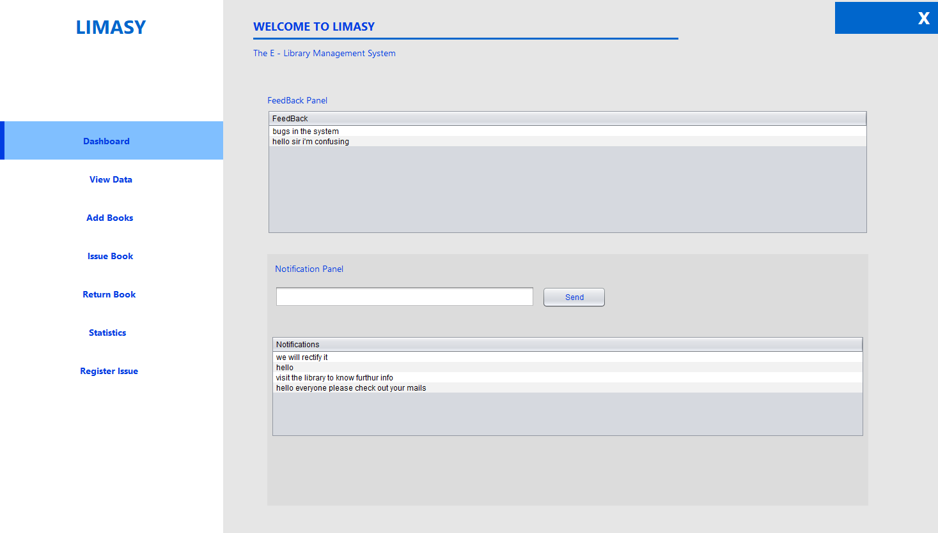
Admin user interface

Slide 13
Conclusion
The issues of the traditional library are identified and we implemented a system to easy access for the library. In this E-Library Management system, the admin can add , update and remove the book details into the database. Also he can issue books and send notifications to the users. Student can search, pre-register and return the books.
Technology advances and never stops, new possibilities must be considered for the future. For the future enhancement we can provide a feature which provides the online lecture videos. A feature of group chat where students can discuss various doubts regarding the lectures. In future we can implement this as a mobile application.

Slide 14
References
https://www.daitm.org.in/wp-content/uploads/2019/04/Gr.-06library-project-report.pdfhttp://en.wikipedia.org/wiki/Library_automation_system
https://www.engpaper.com/cse/jdbc-java-database-connectivity.html
https://www.tabnine.com/code/java/classes/javax.swing.JFrame

Slide 15
Thank you...

